Slide 1
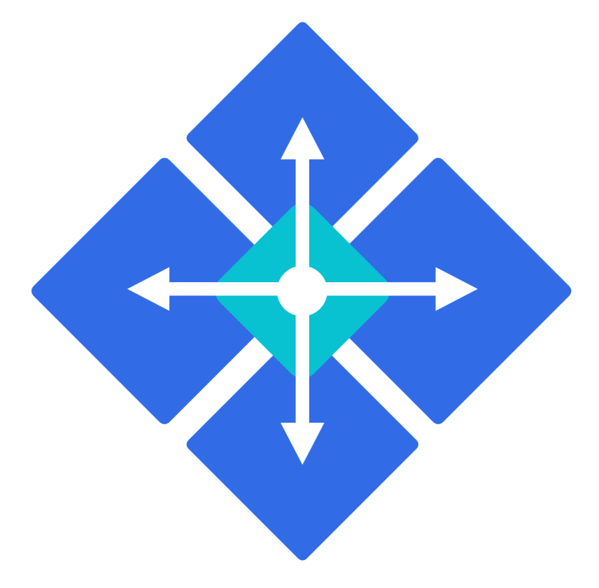
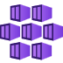
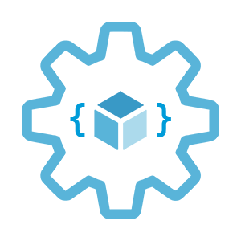

Scaling options
for applications and clusters in AKS
Infrastructure as Code User Group Oslo
27.01.2022
with Evgeny Borzenin

Slide 2
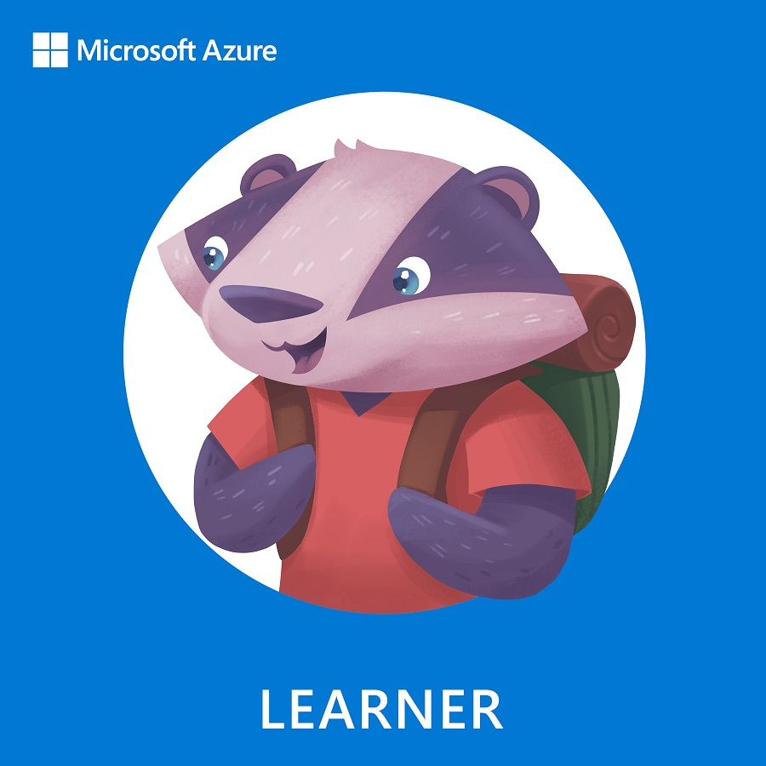
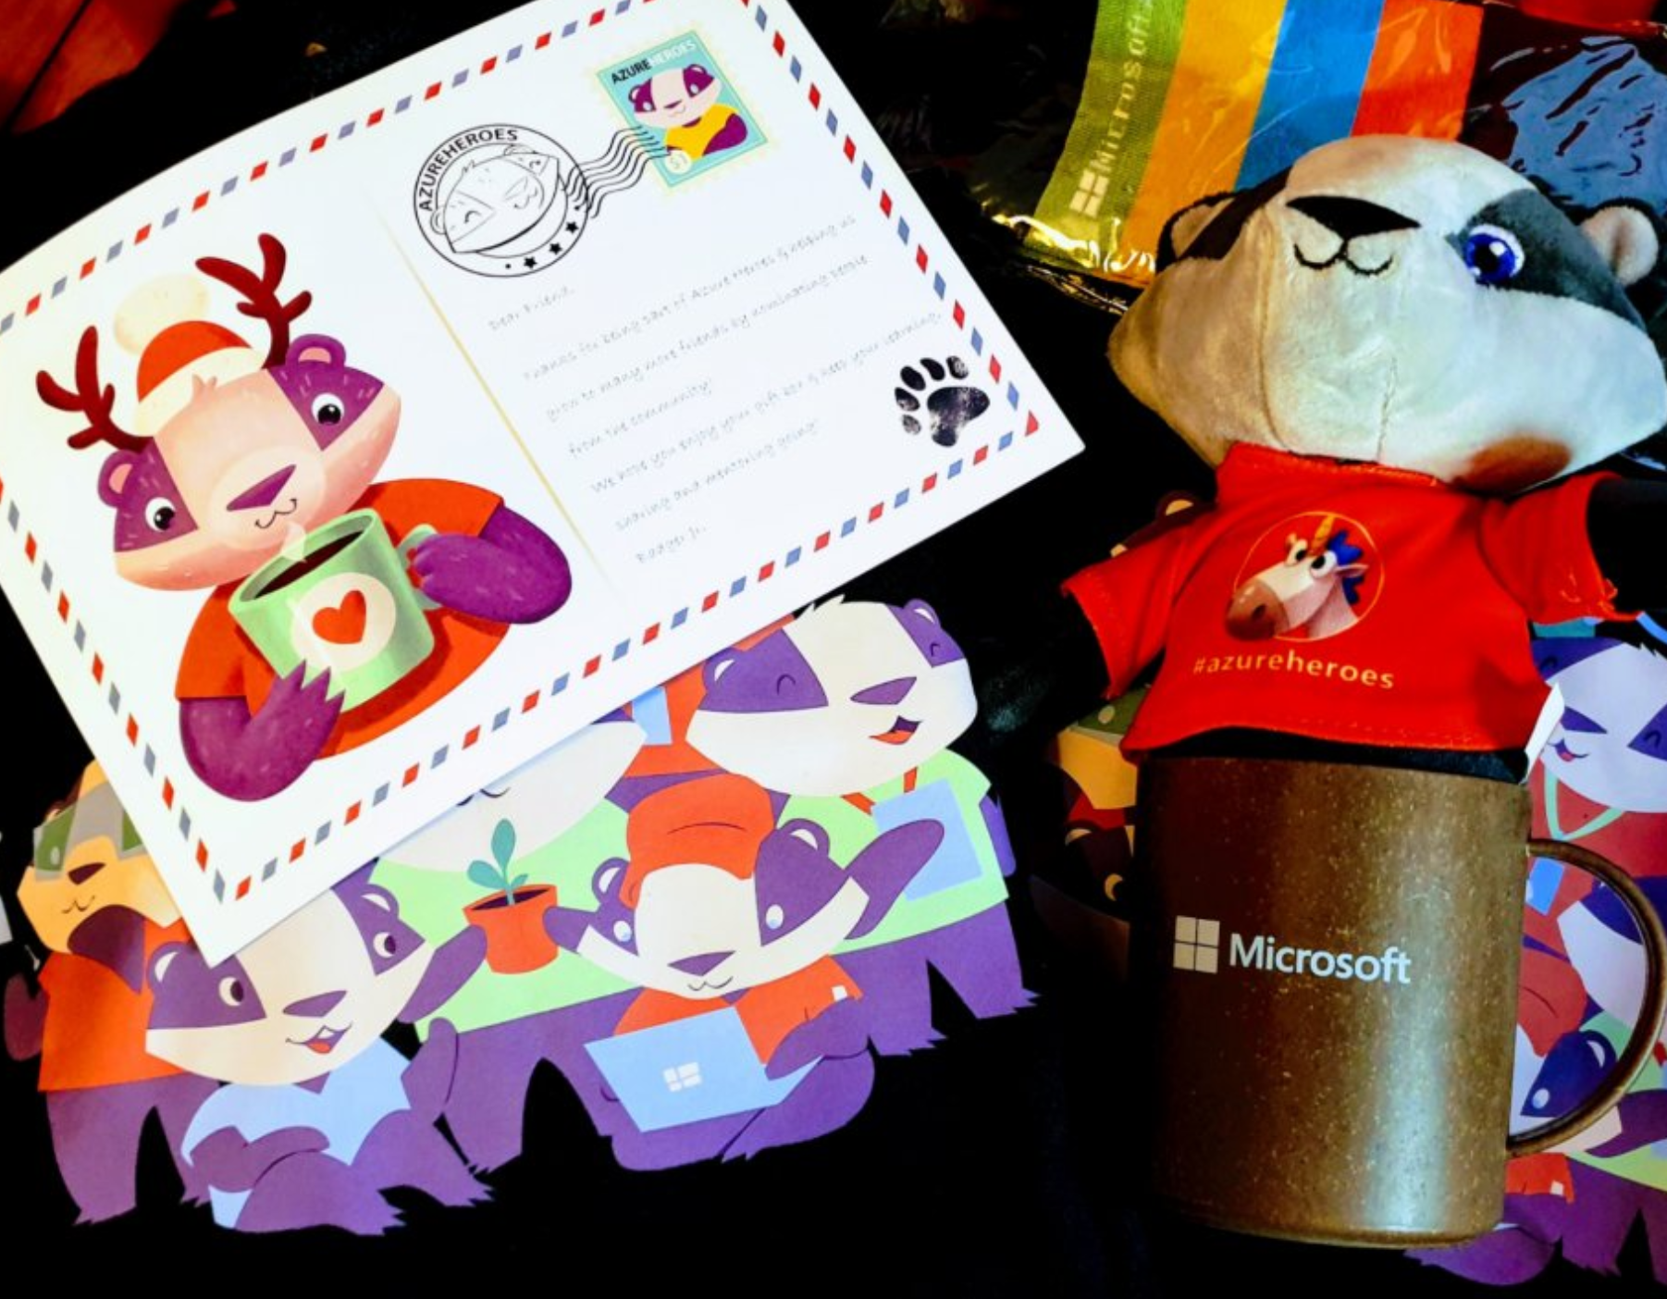
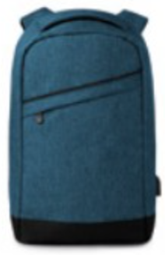


Guide on cluster autoscaling with AKS: https://aka.ms/azure-aks
Get your next Learner digital badge of Azure Heroes program https://aka.ms/azure-heroes-badge
Win a cool Microsoft backpack!
Don’t forget to add Microsoft Azure skill to your LinkedIn account to stay connected with a developer community
+ Microsoft Azure
We post the latest announces about free events for the developers in Norway on our official Twitter account
@MSDevNo
Notes:
Our usergroup partners with Microsoft Norway
On this slide you’ll find a link to the documentation about cluster autoscaling using AKS, and a link to claim your digital badge of the Azure Heroes program.
Also, Microsoft Norway has a tech twitter account where they announce their own and community-driven events for the developers – please follow @MSDevNo to stay updated.
If you want to learn more about autoscaling in AKS, please check the tutorial here: https://aka.ms/azure-aks -
All today’s attendees are welcome to claim their digital badges of the Azure Heroes program. Click here and follow the instructions on how to claim it: https://aka.ms/azure-heroes-badge
Follow https://twitter.com/msdevno to not miss the events for the developers – to learn about Azure and to gather more Azure Heroes badges!

Slide 3
Infrastructure as Code User Group roadmap
AKS workshops roadmap:
[x] AKS and Kubernetes 101
[x] Advanced AKS configuration
[x] Implement Immutable AKS Infrastructure on Azure with Bicep
[x] GitOps in AKS with Flux
[ ] Scaling options for applications and clusters in AKS
[ ] Monitoring options in AKS
[ ] Service mesh in AKS with linkerd
[ ] Security in AKS
+ “regular” events (work in progress)

Slide 4
Practical information
Mix of slides and labs with focus on labs
I don’t have moderator
Let’s help each other, the one who finished earlier can help others
Keep the same names as in labs -> easier to troubleshot
Share your screen if you stack with some issues
Labs are available after the event

Slide 5
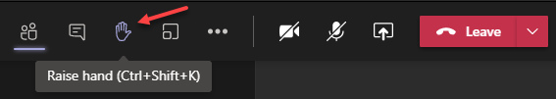
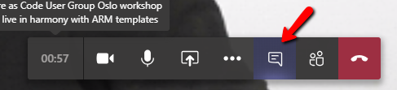
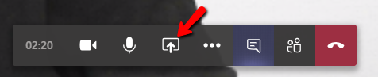
Microsoft Teams 101
Mute your mic (but don’t forget to unmute when you speak)
Feel free to use video
«Rise your hand» if you need some attention
Conversation/chat
Share screen

Slide 6
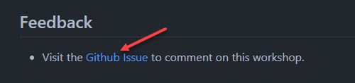
Practical information
Each lab is time-boxed (ish…)
When you done with lab, post to the Conversation channel
lab-01 (lab-02, lab-03 etc…)
Feel free to contribute to the labs content by fixing gramma, typos, wrong commands etc..
Feel free to comment on workshop main page

Slide 7
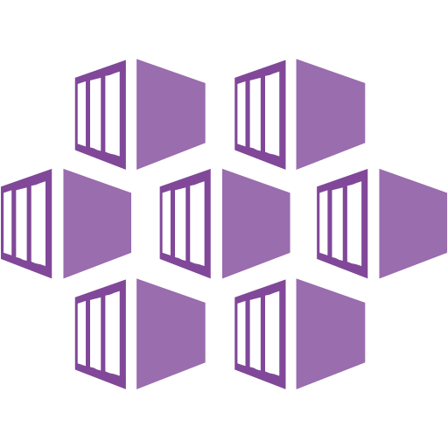
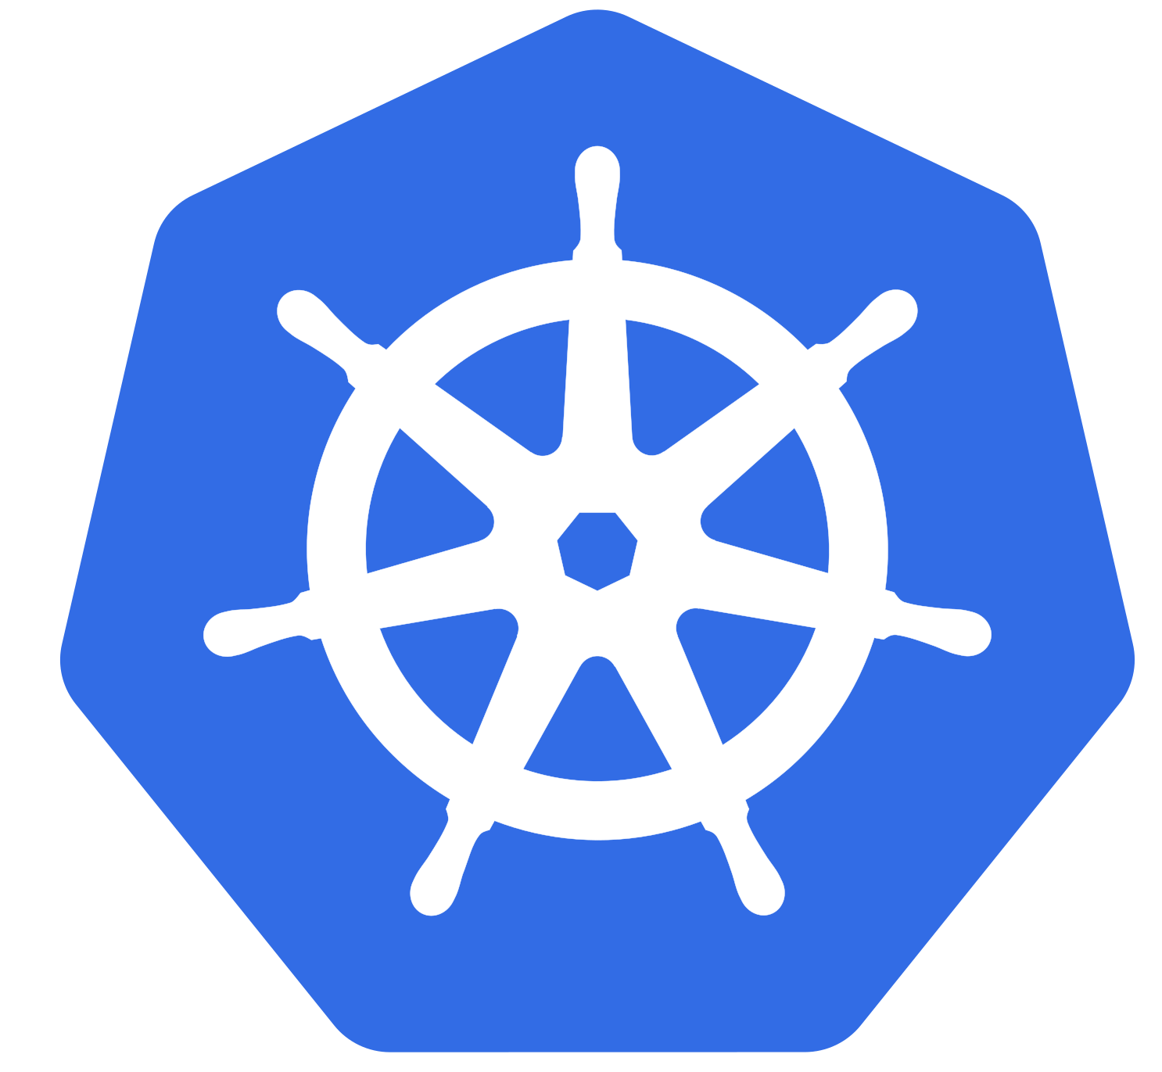
Kubernetes core concepts

Slide 8
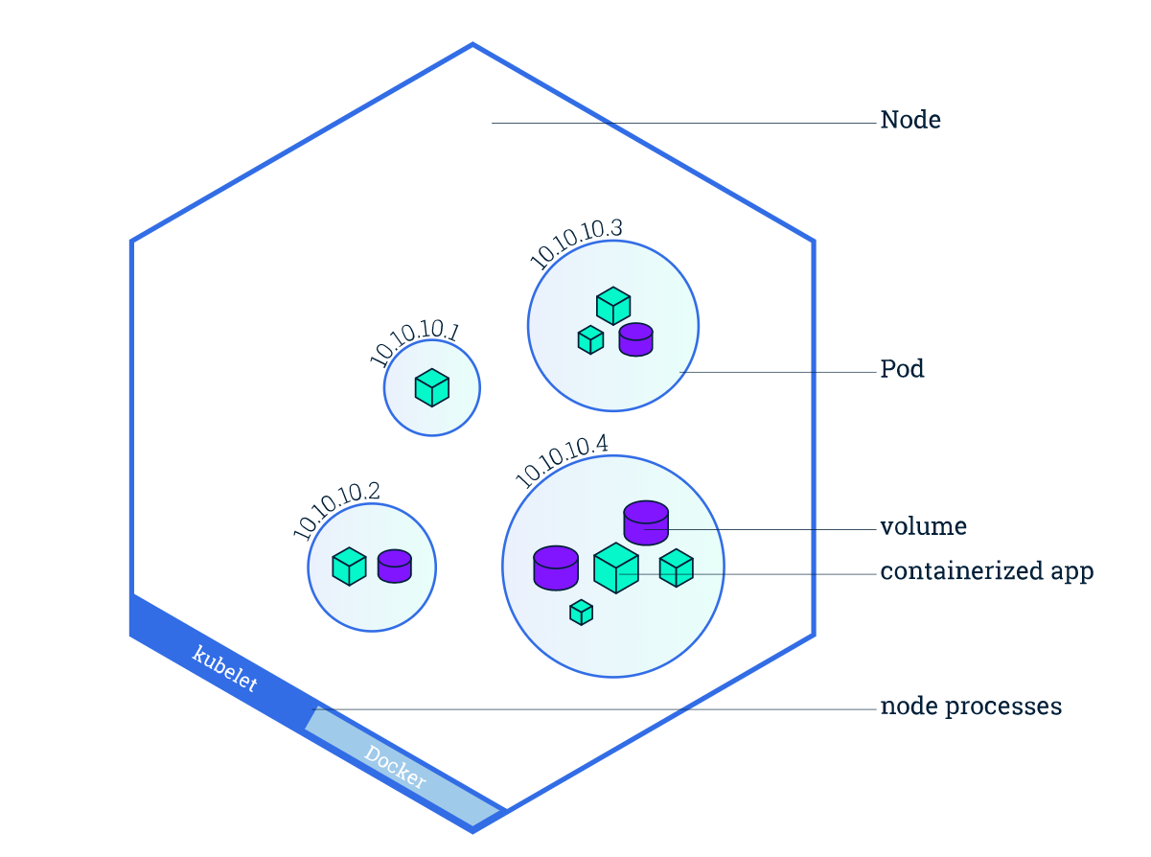
Kubernetes concepts
Cluster
Nodes
Pods
Deployments
Resource management
Horizontal Pod Autoscaling (HPA)
Image from https://kubernetes.io/docs/tutorials/kubernetes-basics/explore/explore-intro/

Slide 9
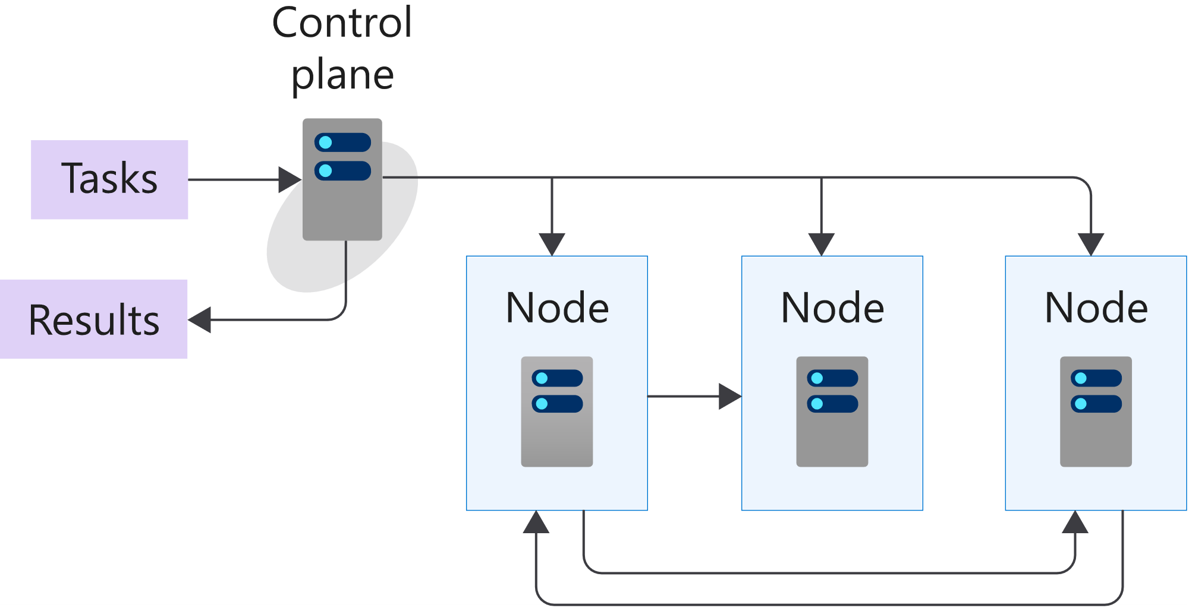
K8s 101: Cluster and Nodes
Azure-managed
Nodes are machines (VM) in your cluster
Nodes are where your workloads run
Nodes can come and go
Customer-managed
Image from https://docs.microsoft.com/en-us/learn/modules/intro-to-kubernetes/3-how-kubernetes-works
Notes:
A cluster is a set of computers that you configure to work together and view as a single system. The computers configured in the cluster will typically do different type of tasks. For example, they'll host websites, APIs, or run compute-intensive batches.
A cluster uses centralized software that's responsible for scheduling and controlling these tasks. The computers in a cluster that run the tasks are called nodes, and the computers that run the scheduling software are called control planes.
A node in a Kubernetes cluster is where your compute workloads run.
Each node communicates with the control plane via the API server to inform it about state changes on the node.

Slide 10
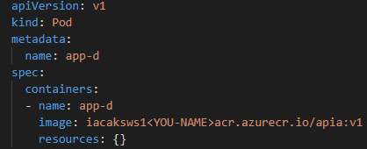
K8s 101: Pods
Pod is the smallest object that you can create
A single Pod can hold a group of one or more containers
Node1
Node2
Node3
pod
pod
pod
pod
app-a
app-b
app-b
app-a
app-d
Notes:
Unlike in a Docker environment, you can't run containers directly on Kubernetes.
You package the container into a Kubernetes object called a pod. A pod is the smallest object that you can create in Kubernetes.
A single pod can hold a group of one or more containers. However, a pod typically doesn't contain multiples of the same app.
You use Kubernetes pod templates to define the information about the pods that run in your cluster.
Pod templates are YAML-coded files
A pod includes information about the shared storage and network configuration, and a specification about how to run its packaged containers.

Slide 11
K8s 101: Desired State
Imperative vs. Declarative - tell Kubernetes what you want, not what to do
Kubernetes always tries to steer the cluster to its desired state
You: “Hey, k8s, I want 3 replicas of app-a”
K8s: “Here are 3 replicas of app-a”
K8s: “Upps, one replica just died, I will try to find a node where I can spin up a new replica”
K8s: “Here are 3 replicas of app-a”
Notes:
(Imperative vs. Declarative)
One of the core concepts of Kubernetes - Desired State. Tell Kubernetes what you want, not what to do.

Slide 12
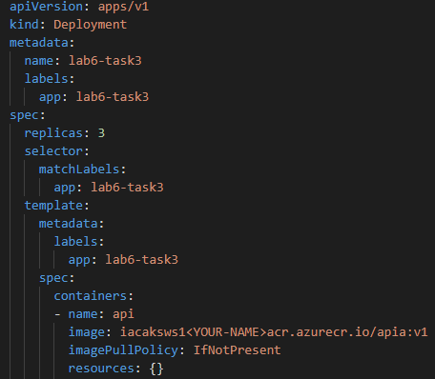
K8s 101: Deployment
Pod templates
Replica Sets
Deployments
Notes:
There are several options to manage the deployment of pods in a Kubernetes cluster
A pod template enables you to define the configuration of the pod you want to deploy.
The template contains information, such as the name of container image, and which container registry to use to fetch the images.
The template may also include runtime configuration information, such as ports to use.
Templates are defined by using YAML.
You can use templates to deploy pods manually. However, a manually-deployed pod isn't relaunched after it fails, is deleted, or is terminated.
To manage the lifecycle of a pod, you need to create a higher-level Kubernetes object.
A replica set uses pod templates and defines a specified number of pods that must run
A deployment creates a management object one level higher than a replica set and enables you to deploy and manage updates for pods in a cluster.

Slide 13
K8s 101: Deployment
Deployments are requirements you give to Kubernetes regarding your applications (Pods)
k8s: I need 2 replicas of app-a and 3 replicas of app-b
Node1
Node2
Node3
pod
pod
pod
pod
pod
app-a
app-b
app-b
app-a
app-b

Slide 14
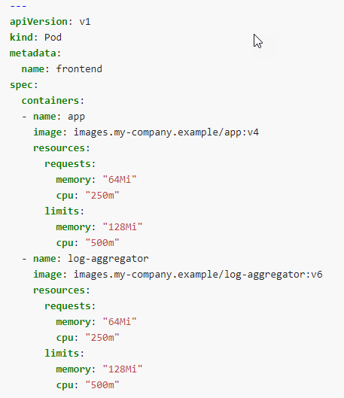
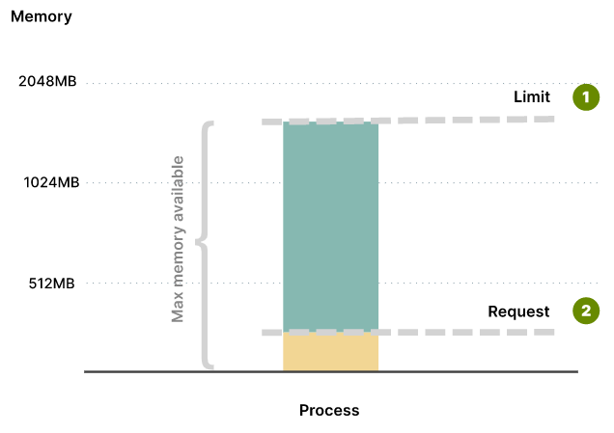
K8s 101: Resource Management
Requests - define the minimum amount of resources that containers need
Limits - define the max amount of resources that the container can consume
Image from https://learnk8s.io/setting-cpu-memory-limits-requests
Notes:
When you specify a Pod or Deployment, you should specify how much of each resource a container needs. The most common resources to specify are CPU and memory (RAM); there are others.
When you specify the resource request for containers in a Pod, the kube-scheduler uses this information to decide which node to place the Pod on.
When you specify a resource limit for a container, the kubelet enforces those limits so that the running container is not allowed to use more of that resource than the limit you set. The kubelet also reserves at least
the request amount of that system resource specifically for that container to use
Your application might require at least 256MB of memory, but you might want to be sure that it doesn't consume more than 1GB of memory.
Setting limits is useful to stop over-committing resources and protect other deployments from resource starvation

Slide 15
K8s 101: CPU and memory units
CPU units
One CPU = 1 physical CPU core (or virtual core) = 1 = 1000 m (millicores or millicpu)
0.1 = 100m
400m = 0.4
Memory units
measured in bytes
128974848, 129e6, 129M, 128974848000m, 123Mi
Notes:
In Kubernetes, the CPU is not assigned in percentages, but in millicpu (or millicores)

Slide 16
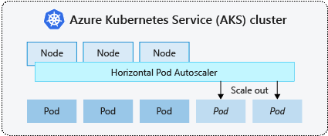
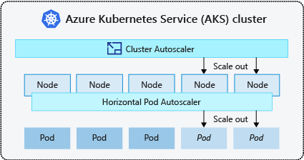
K8s 101: AKS scaling options
Manually scale pods and nodes
Horizontal Pod Autoscaler
Vertical Pod Autoscaler
Cluster autoscaler
KEDA
https://docs.microsoft.com/en-us/azure/aks/concepts-scale

Slide 17
K8s 101: Manually scale pods and nodes
Manually scale pods
kubectl scale deployment/guinea-pig --replicas=3
kubectl scale deployment/guinea-pig --replicas=0
Manually scale nodes
az aks scale -g iac-ws5-rg -n iac-ws5-aks --node-count 2
https://docs.microsoft.com/en-us/azure/aks/concepts-scale

Slide 18
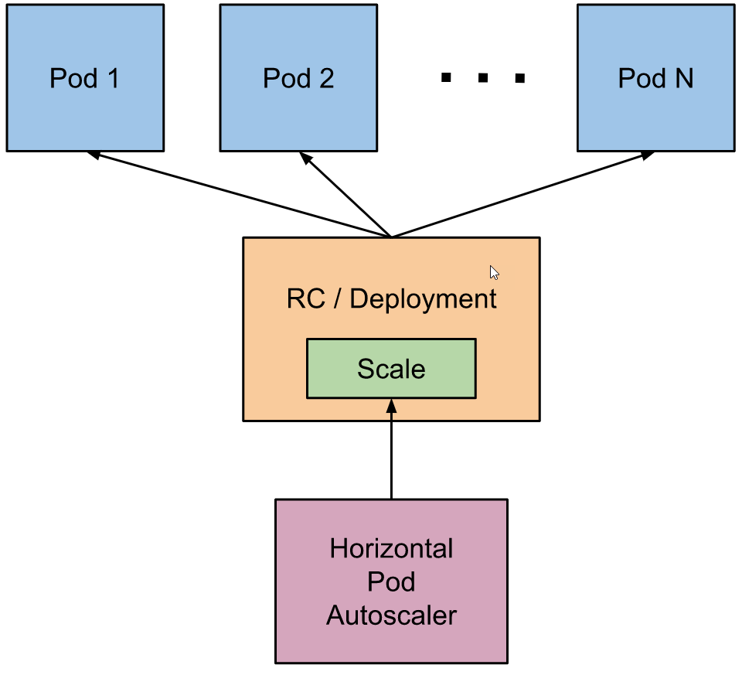
K8s 101: Horizontal Pod Autoscaler
checks the metrics server for resource usage every 30 sec
calculates the desired number of replicas required
scales up the application to the desired number of replicas
Image from: https://kubernetes.io/docs/tasks/run-application/horizontal-pod-autoscale/
Notes:
Kubernetes uses the horizontal pod autoscaler (HPA) to monitor the resource demand and automatically scale the number of replicas.
By default, the horizontal pod autoscaler checks the Metrics API every 30 seconds for any required changes in replica count.
When changes are required, the number of replicas is increased or decreased accordingly.

Slide 19
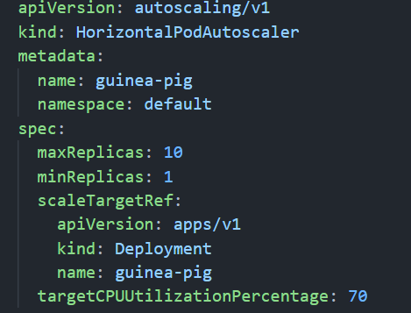
K8s 101: Horizontal Pod Autoscaler
kubectl autoscale deployment guinea-pig
--cpu-percent=70 --min=1 --max=10
Notes:
When you configure the horizontal pod autoscaler for a given deployment, you define the minimum and maximum number of replicas that can run.
You also define the metric to monitor and base any scaling decisions on, such as CPU usage.

Slide 20
K8s 101: Cluster autoscaler
autoscaler checks the Metrics API server every 10 seconds
if determines that a change is required, the number of nodes is increased or decreased
used alongside the horizontal pod autoscaler
https://docs.microsoft.com/en-us/azure/aks/concepts-scale
Notes:
To respond to changing pod demands, Kubernetes has a cluster autoscaler, that adjusts the number of nodes based on the requested compute resources in the node pool.
By default, the cluster autoscaler checks the Metrics API server every 10 seconds for any required changes in node count.
If the cluster autoscale determines that a change is required, the number of nodes in your AKS cluster is increased or decreased accordingly.
Cluster autoscaler is typically used alongside the horizontal pod autoscaler. When combined, the horizontal pod autoscaler increases or decreases the number of pods based on application demand, and the cluster autoscaler adjusts the number of nodes as needed to run those additional pods accordingly.

Slide 21
Lab-01, 02, 03

Slide 22


Slide 23
Lab-04, 05, 06, 07

Slide 24
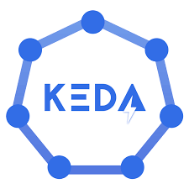
Kubernetes Event Driven Autoscaling KEDA

Slide 25

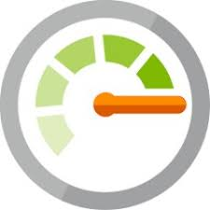

KEDA concepts
Prometheus
Metric Adapter
Azure Monitor
Metric Adapter
Autoscaling infra
Kubernetes Custom Metrics
Horizontal Pod Autoscaler
(HPA)
Horizontal Pod Autoscaler
(HPA)
Horizontal Pod Autoscaler
(HPA)
Customer
Deployment
Order
Deployment
Shipment
Deployment

Slide 26

KEDA concepts
Autoscaling infra
Prometheus
Scaler
Azure Service Bus
Scaler
Scale Controller
Horizontal Pod Autoscaler
(HPA)
ScaledObject
ScaledObject
ScaledObject
Customer
Deployment
Order
Deployment
Shipment
Deployment

Slide 27
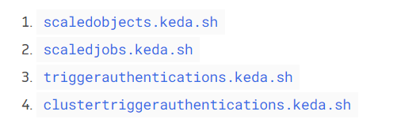
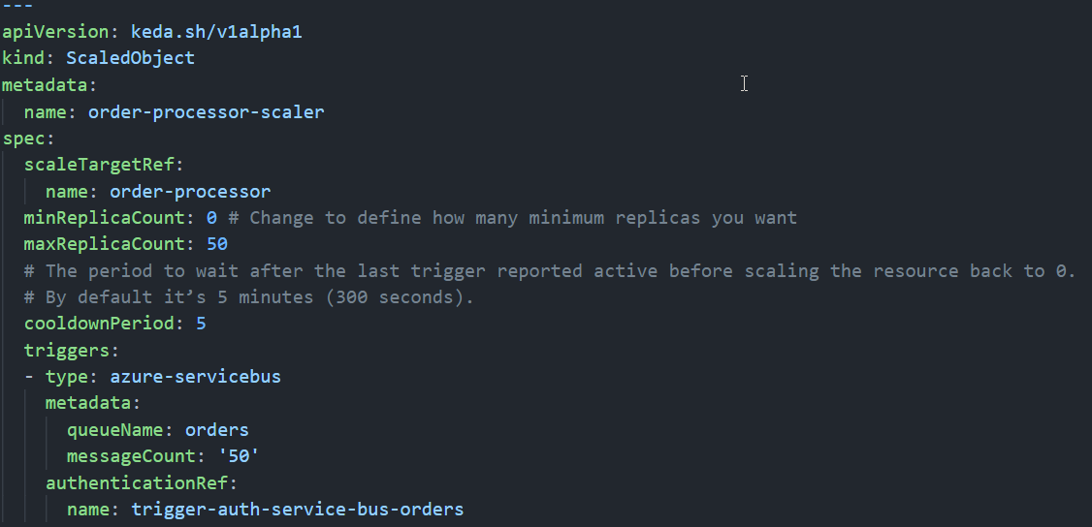
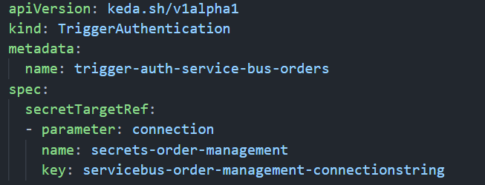
KEDA custom resources
Image from https://keda.sh/docs/2.5/concepts/

Slide 28
Lab-08, 09, 10

Slide 29
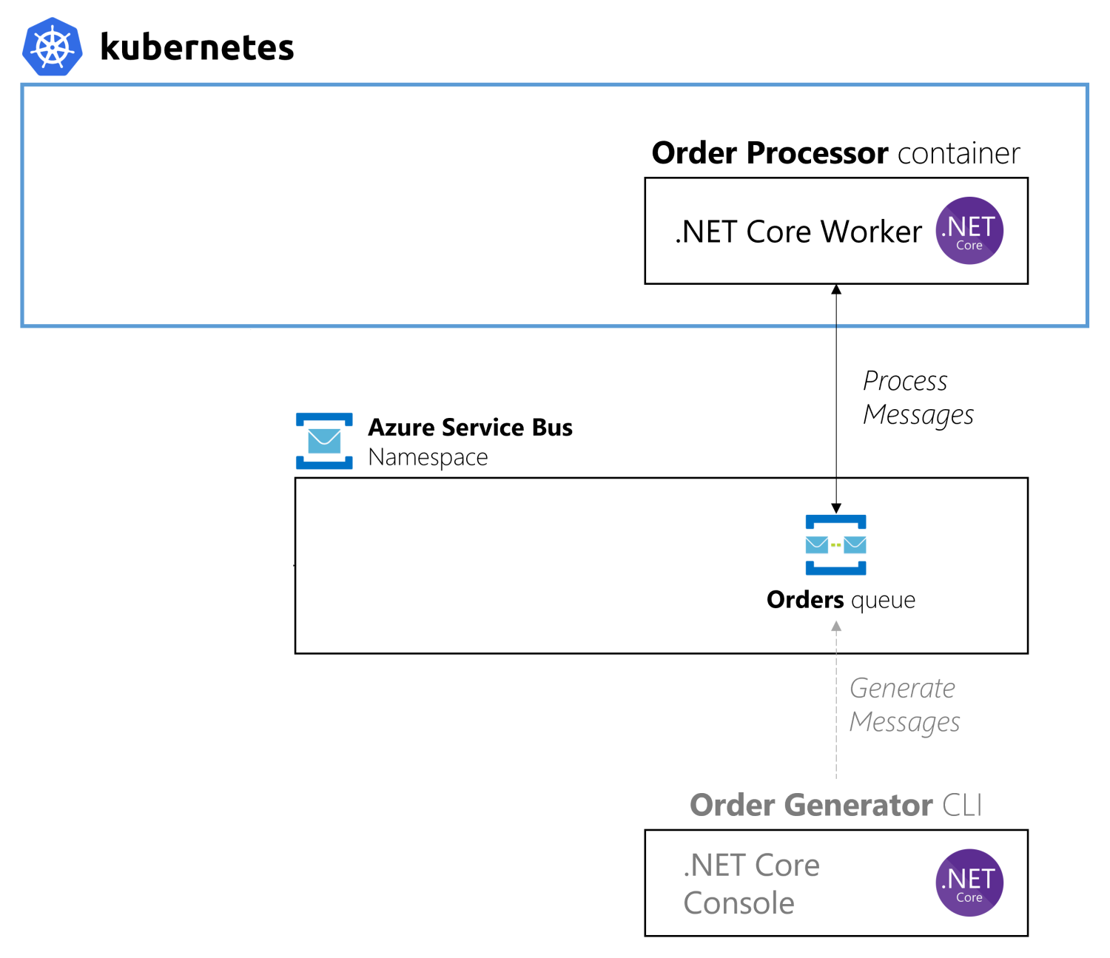
Lab-09 use case
order-processor k8s app
order-generator cli
Azure Service Bus namespace
orders queue
Image based on https://github.com/kedacore/sample-dotnet-worker-servicebus-queue

